Slide 1
Maintaining Sibling Relationships

Slide 2
Contact Between Siblings
Sibling relationships are amongst our longest lasting relationships and contribute greatly to our sense of identity. Research has demonstrated that positive sibling relationships can provide a source of resilience for children facing adversity and provide continuity at a time of change and uncertainty. They can also be a source of support into adulthood. Placing siblings together has been associated with increased wellbeing and stable, enduring placements.
(‘Prioritising Sibling Relationships for Looked After Children’. Fiona Jones (ClanChildlaw) & Dr Christine Jones (Strathclyde University) 2018)

Slide 3
Contact Between Siblings
Despite these benefits, sibling separation and estrangement are common outcomes when children become looked after and accommodated. Research has estimated that around 70% of children in care experience separation from siblings. Where this occurs children typically express a strong desire to stay in contact with brothers and sisters yet contact varies in quality and tends to become less frequent over time. This is a source of distress for children and a concern of professionals working on their behalf.
(‘Prioritising Sibling Relationships for Looked After Children’. Fiona Jones (ClanChildlaw) & Dr Christine Jones (Strathclyde University) 2018)

Slide 4
Contact Between Siblings
Research has recommended that children should not be separated from their siblings on admission into care and if this occurs children should be reunited speedily in order to avoid brothers and sisters losing a shared sense of their development and identity.
Interventions designed to promote positive sibling relationships and reduce sibling conflict have also been shown to be effective.
(‘Prioritising Sibling Relationships for Looked After Children’. Fiona Jones (ClanChildlaw) & Dr Christine Jones (Strathclyde University) 2018)

Slide 5
Brothers and Sisters
The care review has heard many stories from care experienced people about ‘contact’ with the care system has led to them being separated from their brothers and sisters. The pain of that separation has often been profound and had life long consequences.
Sibling relationships can be complicated and it should not be assumed that they are always easy.
Decision making must take account of the dynamics of sibling relationships and all sibling voices must be heard.
(Chapter 4 Care page 62)
Independent Care Review

Slide 6
Scotland must ensure:
An expansive understanding of siblings that includes half, step and adoptive and reflects children’s experience of their family lives.
Public service planning and commissioning strategies and procurement attuned to the needs of brothers and sisters to promote those relationships and prevent separation.
See page 62 for more……..
Independent Care Review
https://www.carereview.scot/wp-content/uploads/2020/02/The-Promise.pdf

Slide 7
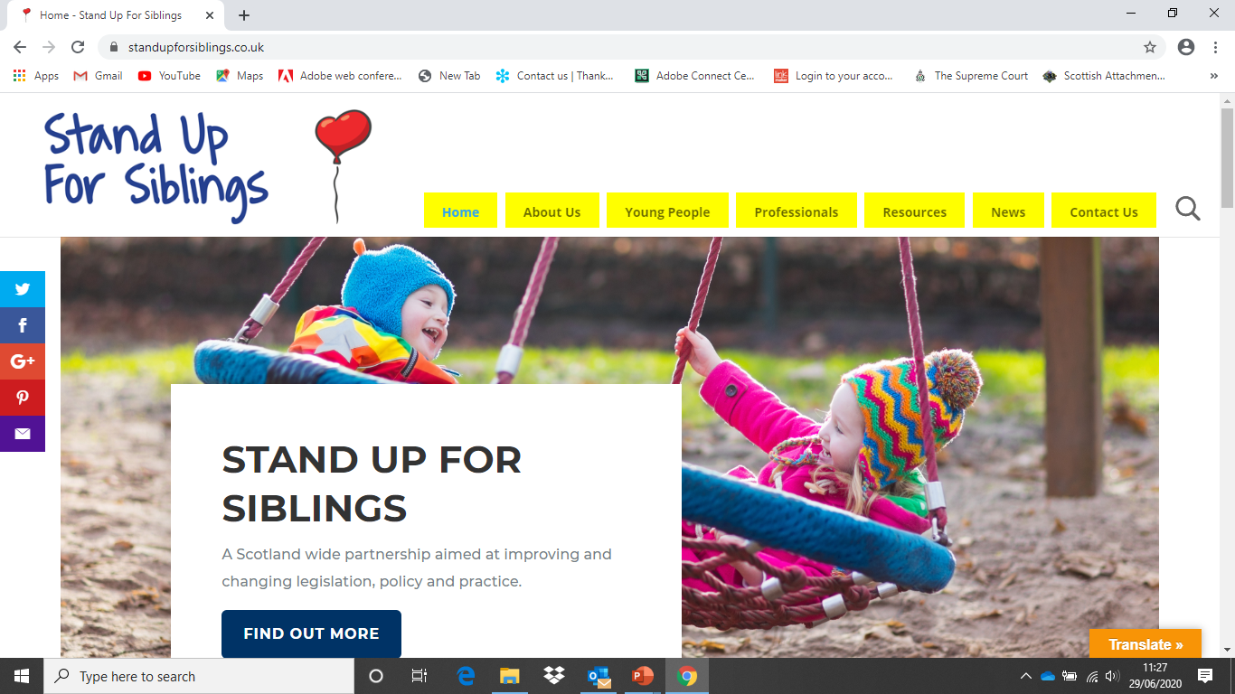

Slide 8
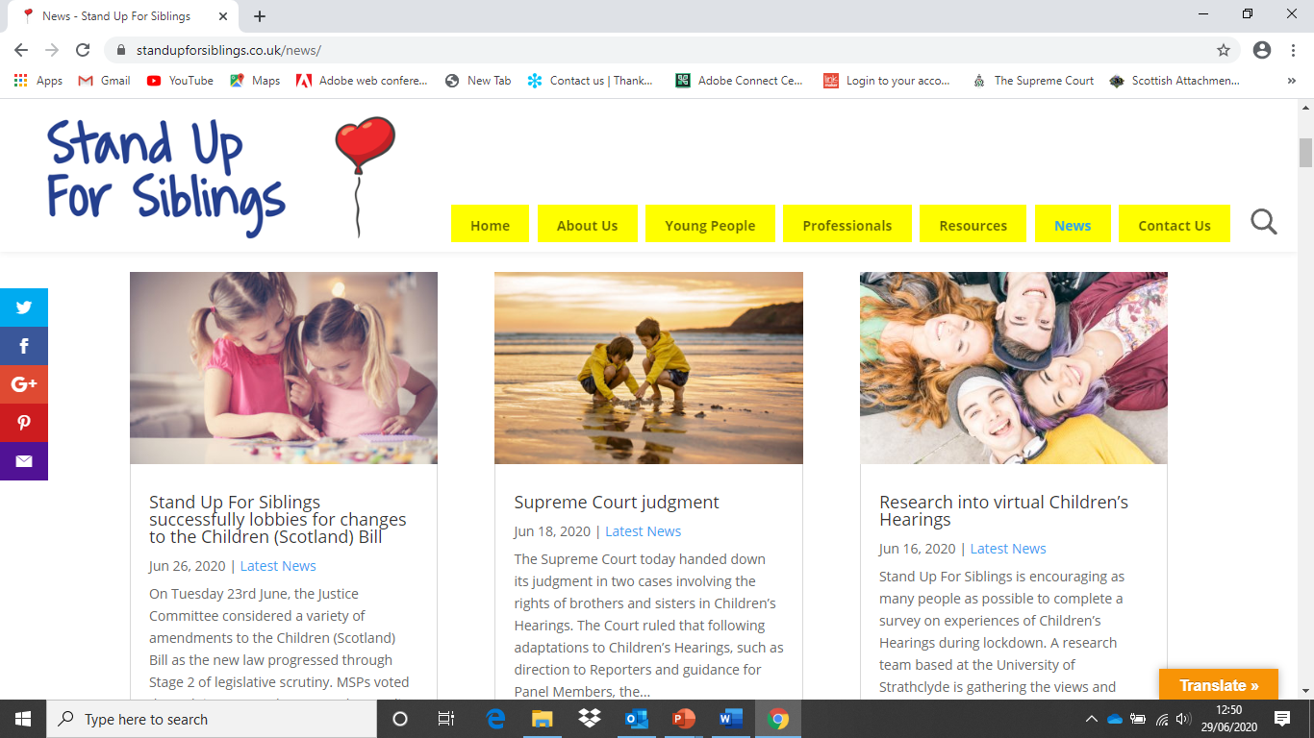

Slide 9
In Section 10 of the Children (Scotland) Bill, it previously stated that a local authority will have a duty to “…take such steps to promote, on a regular basis, personal relations and direct contact between the child and [their sibling where] both practicable and appropriate.” SUFS has consistently suggested that greater clarity was needed regarding the use of the term ‘practicable’ and wrote to MSPs ahead of both the Stage 1 and Stage 2 debates to ask for this term to be removed from the wording of the Bill.
Stand Up For Siblings and the Children (Scotland) Bill

Slide 10
This lobbying effort resulted in the Minister lodging an amendment in Stage 2 on behalf of the Scottish Government to remove the word ‘practicable’ from this new duty on local authorities to promote sibling contact, which was passed unanimously by the Justice Committee.
Stand Up For Siblings and the Children (Scotland) Bill

Slide 11
An amendment was passed unanimously to the Bill, which has added a duty on children’s hearings to consider contact between a child and their siblings, with SUFS being mentioned as a key group who has pushed for this ask continuously:
“On amendment 31, one of the asks in the Stand Up For Siblings pledge for siblings is to introduce a duty on children’s hearings to consider contact between a child and their siblings. Amendment 31 does that…
…Amendment 31 allows children’s hearings to take a bespoke approach to the relationship between siblings.”
https://www.standupforsiblings.co.uk/2020/06/26/stand-up-for-siblings-successfully-lobbies-for-changes-to-the-children-scotland-bill/
Stand Up For Siblings and the Children (Scotland) Bill

Slide 12
Discussion
How do we maintain relationships with our own family members?
Shouldn’t this be the normative experience for children no longer living with their siblings or other children with whom they consider to be important to them e.g. foster siblings?
How do we promote and maintain these relationships?

Slide 13
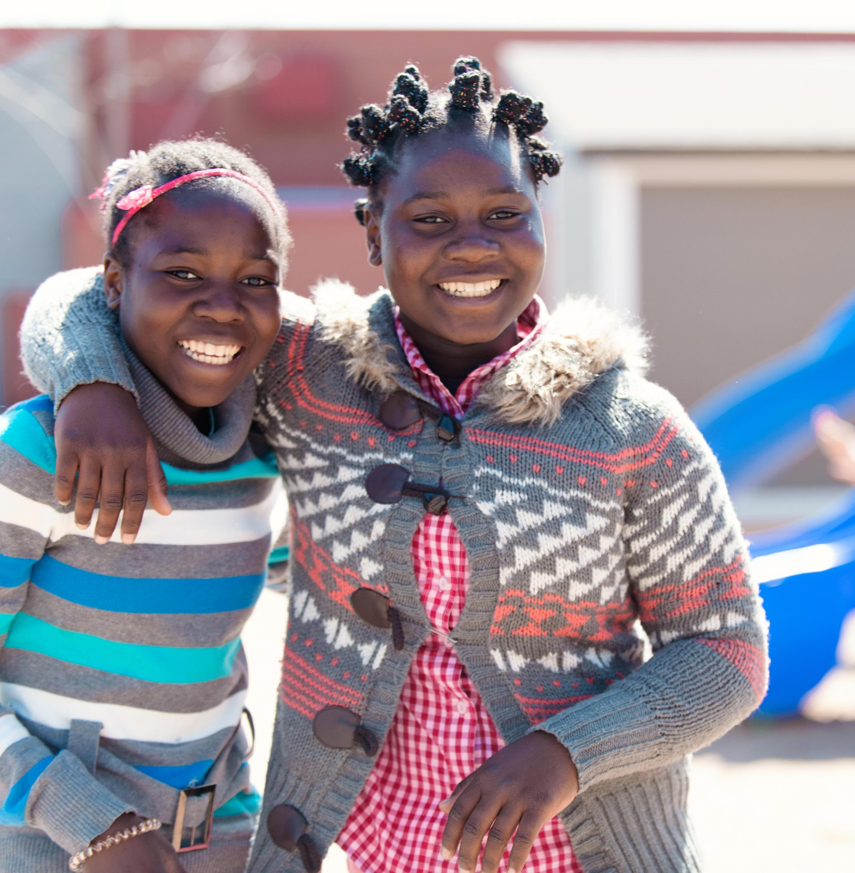
Meeting Up
The ideal scenario is for children to experience ‘normal family life’.
Can they meet up with siblings at the park, at the beach, at each other’s homes?
Can they have sleepovers?
Can this be arranged between families; be they Foster, Adoptive, Kinship?
Let’s move away from referring to “Contact” and instead focus on “catching up”, “play dates” etc.

Slide 14
Keeping in Touch
Telephone calls
Video Call – Skype, FaceTime, Zoom etc
Postcards
Letters/pictures
Email

Slide 15
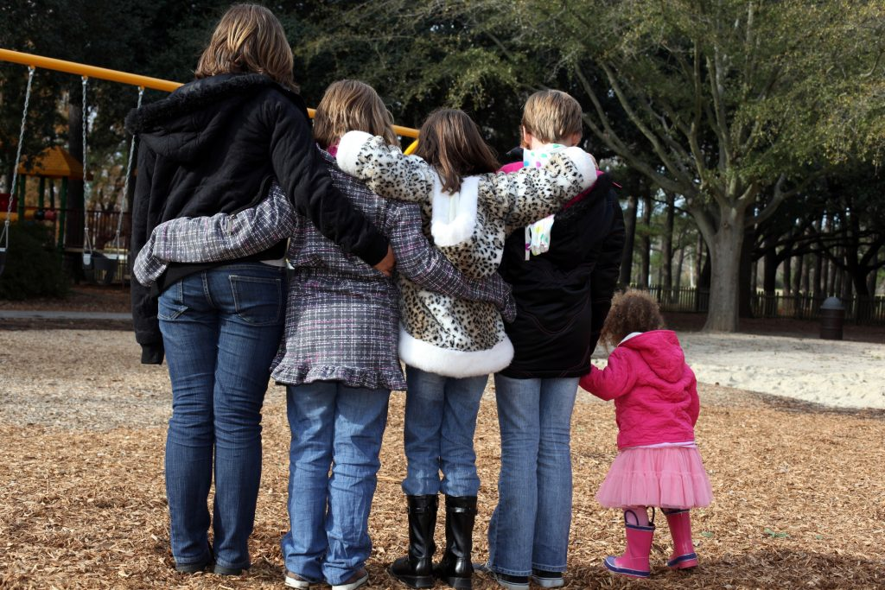
Thank you!

