Slide 1



SIRCC Conference 2019
Young Inspection Volunteers
Supporting and promoting sibling relationships

Slide 2

Background
Innovation fund
Young Inspection Volunteers-Level 7 HNC qualification-Connection and voice
Filming- skills and messages
Health and Social Care Standards-Across the lifespan
Chance to connect and collaborate- CELCIS, Independent Care Review and Stand up for Siblings
Introduce first film- discussion

Slide 3
Siblings
Some of the words and phrases we came up with:

Slide 4
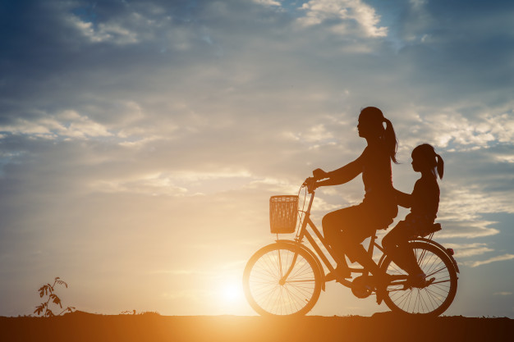
Sharing

Slide 5

Special Bond

Slide 6
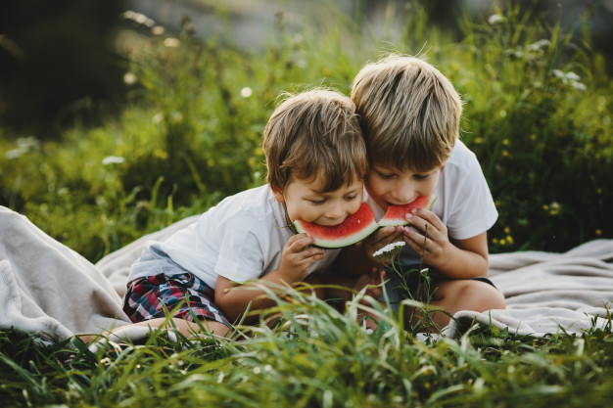
Shared Experiences

Slide 7
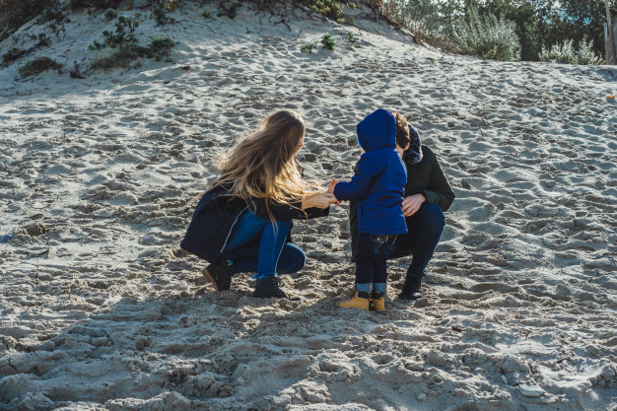
Age gap becomes less important over time

Slide 8

Dramatic

Slide 9

Someone to turn to

Slide 10

Push Buttons

Slide 11
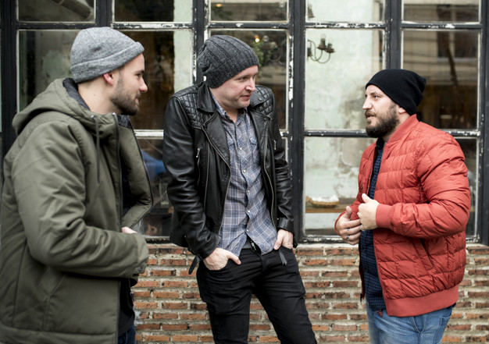
Connection

Slide 12

Stressful

Slide 13
Stranger

Slide 14
Siblings Matter
Enduring relationship.
Evolve and change.
Similarities and differences.
Important source of lifetime support, sense of self and identity.
Build on strengths and support

Slide 15

2.13 If a decision is taken against my wishes, I am supported to understand why.

Slide 16
4.10 As a child or young person unable to live with my immediate family, I can live with wider family members alongside my brothers and sisters if I want this and where it is possible and safe.

Slide 17
Discussion
Take some time to discuss the scenarios you have been given in small groups.
Share and discuss examples from your own practice of the success and challenges in supporting sibling relationships.

Slide 18
Next Steps
Moving Forward- Thomas

