Slide 1
Community of Practice for Siblings
Rossie Young People’s Trust

Slide 2
Schedule
Welcome, Introductions and Housekeeping
Rossie Young People’s Trust
Coffee break
Rossie for Brothers and Sisters
Lunch
CLAN Child law
Break out sessions
Feedback
Plenary

Slide 3
Welcome!

Slide 4
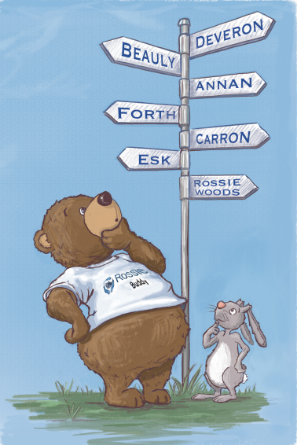
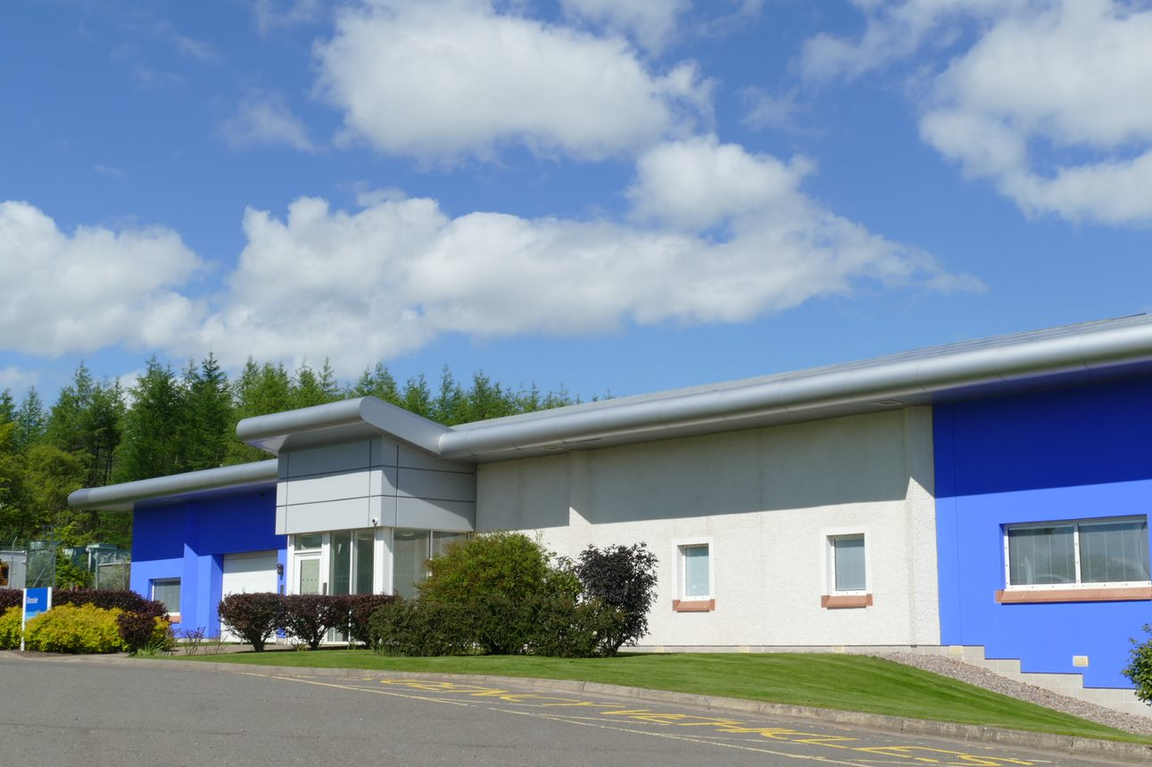
A bit about Rossie
Established in 1857
UK’s first secure service- 1962
Opened to girls in 1986
New building opened in 2009
Multi- agency service
Up to 36 children and young people can live with us
Short breaks
Charitable status
Info for brothers and sisters

Slide 5
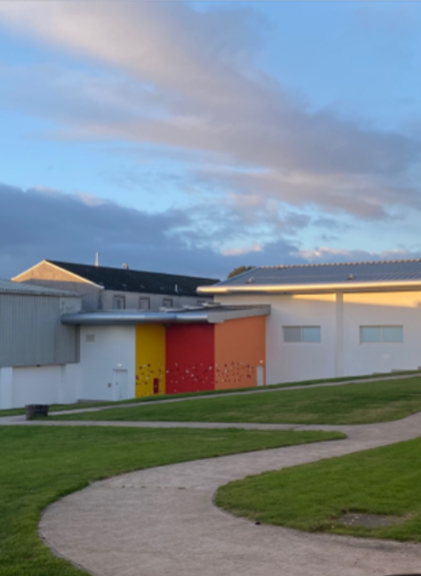
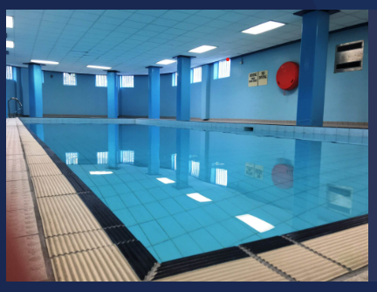
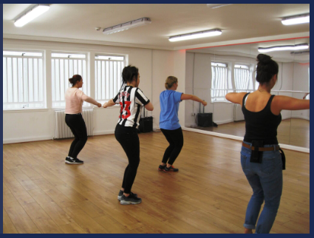
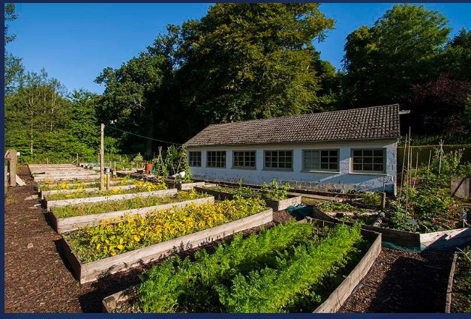
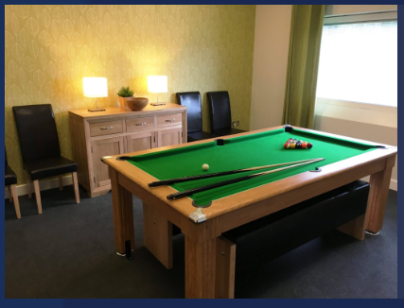
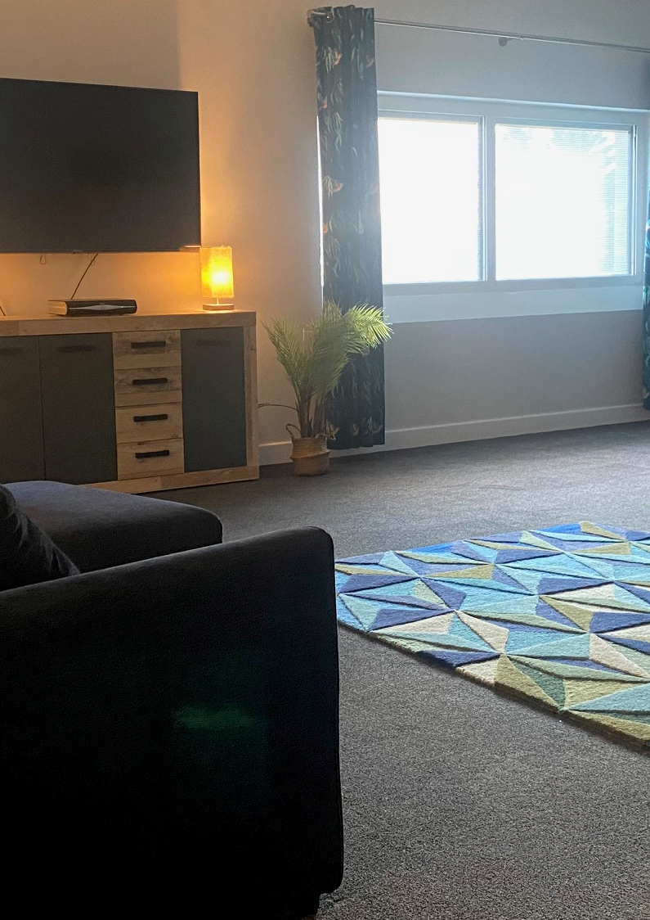
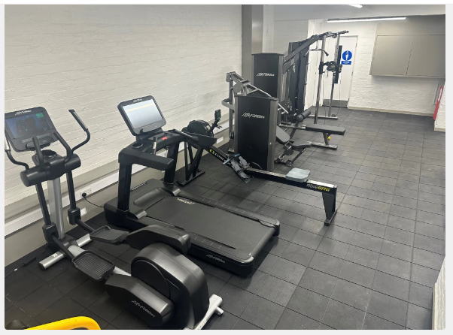
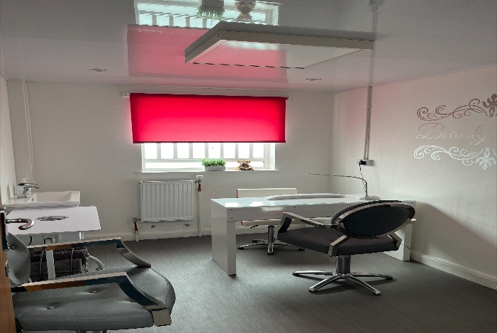

Slide 6
Any questions/ comments?

Slide 7
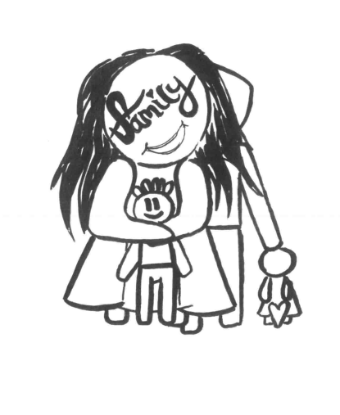
Rossie for Brothers and Sisters

Slide 8
If an idea is worth doing, it’s worth stealing!

Slide 9
Timeline
Funding application made to CORRA foundation in November 2023
Options appraisal work
Board decision reached in March 2024
Design phase 1- April 2024
Planning/ building warrant and tendering- May 2024

Slide 10
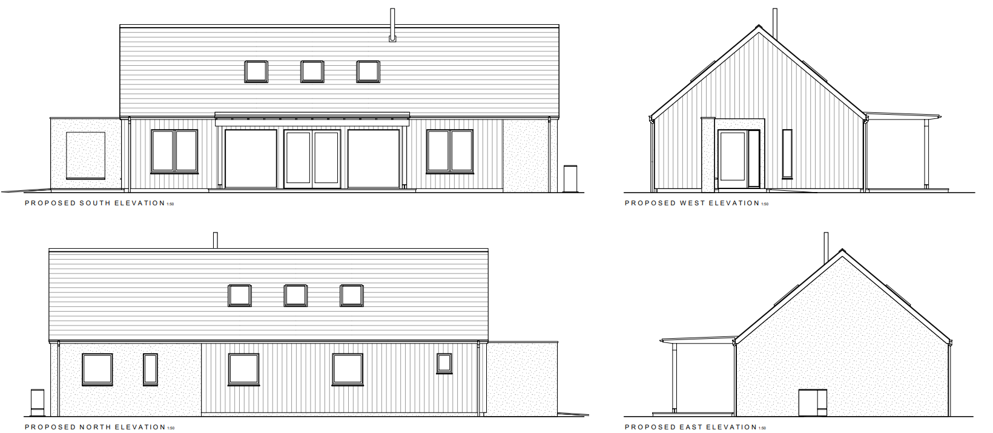

Slide 11
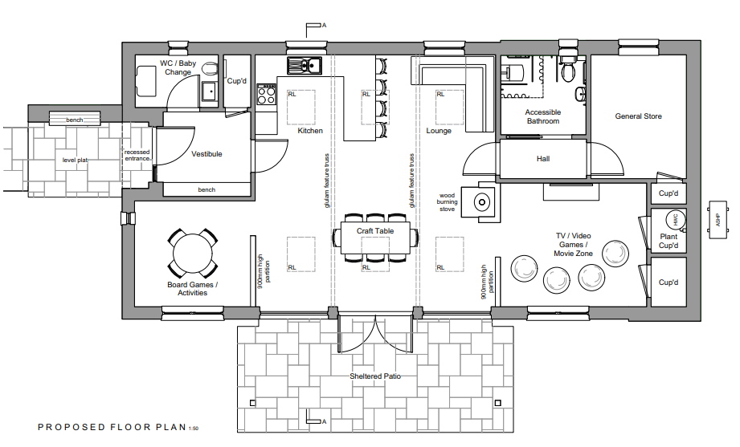

Slide 12
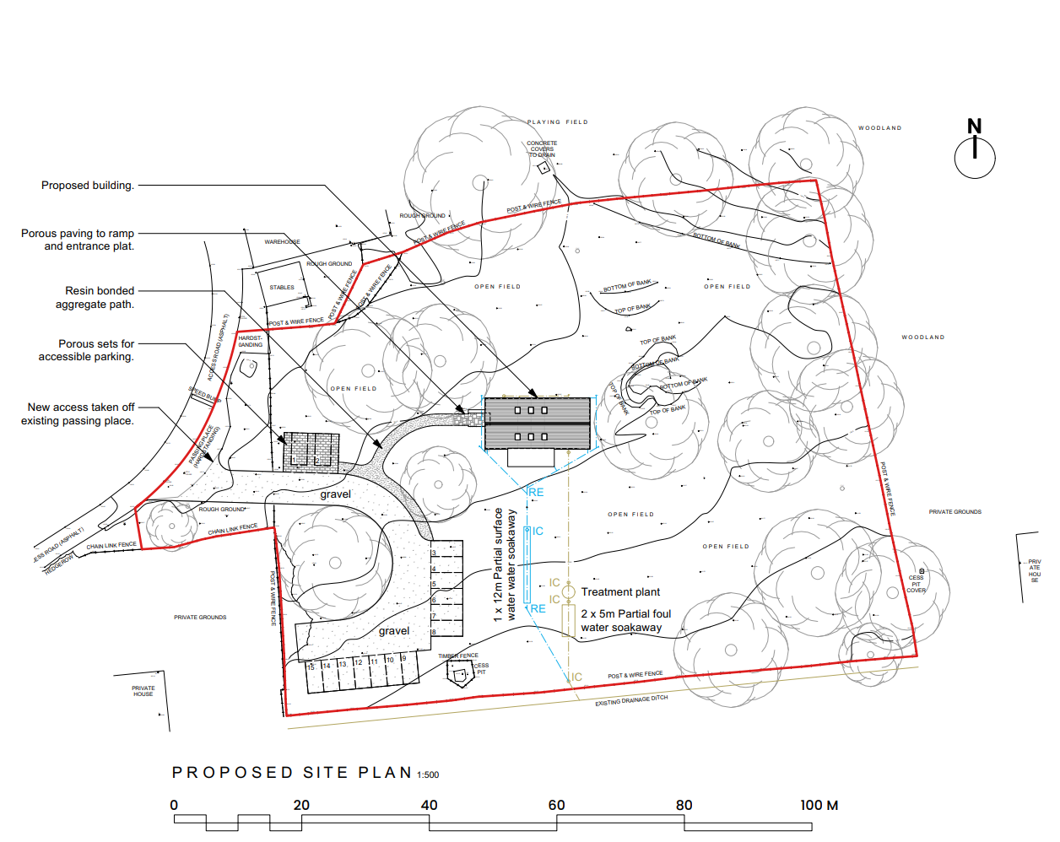

Slide 13
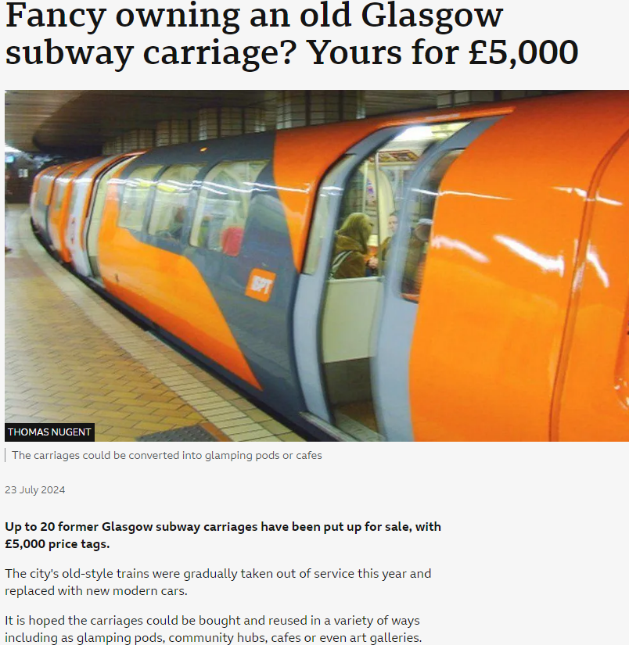

Slide 15
Questions?

Slide 16
Breakout sessions
Conference room: CLAN Childlaw
Room 2: Rossie Secure care
Room 1: Rossie Residential care

Slide 17
Coffee break
Thank you, and
Michael.scanlin@rossie.org.uk

